Slide 1
VMware HA Deep Dive
Eric Sloof – NTPRO.NL

Slide 2
Module 1
Admission Control Policies
Notes:
Quick Poll: Who uses disk defragmentation tools inside your VMs?

Slide 3
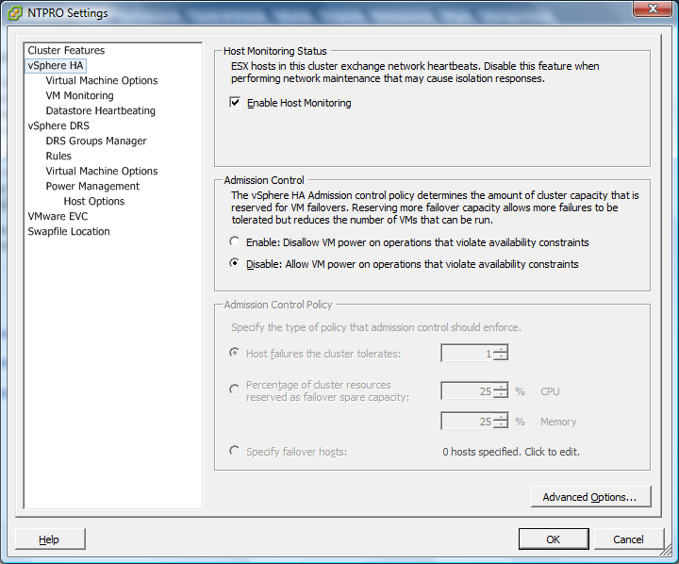
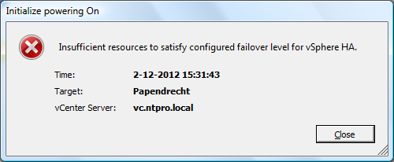
Most Configured Admission Control Policy
WHY?

Slide 4
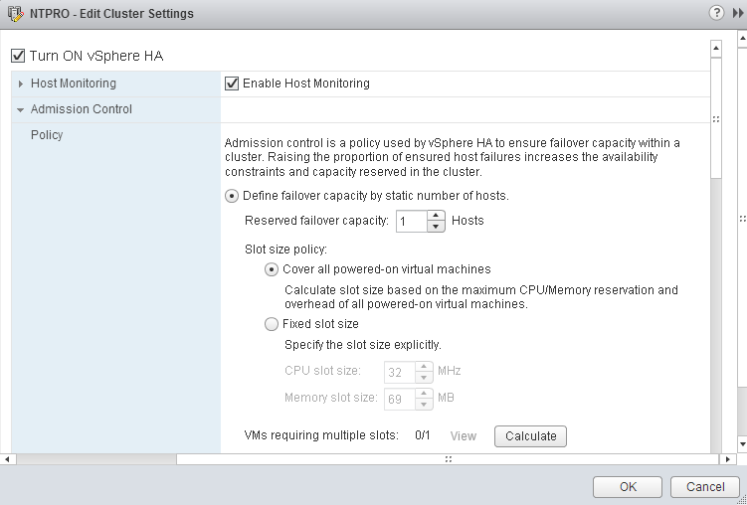
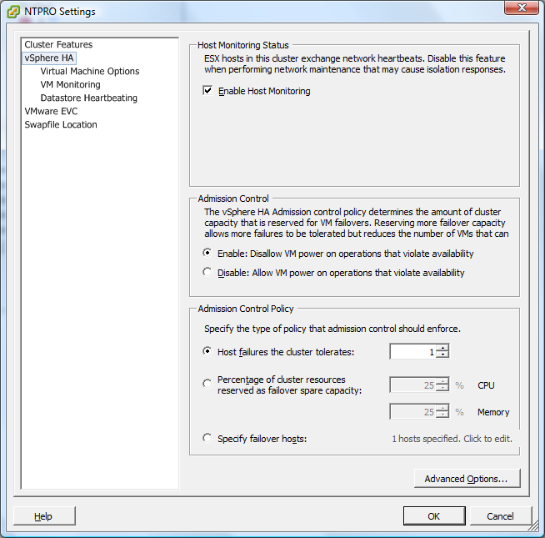
Enabling VMware High Availability

Slide 5
Host Failures a Cluster Tolerates
ESX01
ESX02
ESX03
Shared storage – vm.vmdk

Slide 6
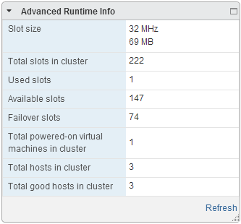
Default minimum Slot size
VM1
VM2
VM3
VM4
VM..n
32 MHz
69 MB
If you have not specified a CPU reservation for a virtual machine, it is assigned a default value of 32MHz.
When the memory reservation is 0, the slot size equals the virtual machine overhead.

Slide 7
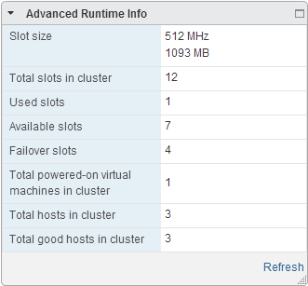
Slot size based on reservation
VM1
VM2
VM3
VM4
VM…n
512 MHz
1093 MB
vSphere HA calculates the CPU and memory slot size by obtaining the largest CPU and memory reservation of each powered-on virtual machine.

Slide 8
HA advanced settings
das.slotmeminmb
das.vmmemoryminmb
Memory reservation
SLOT
das.slotcpuinmhz
das.vmcpuminmhz
CPU reservation
SLOT

Slide 9
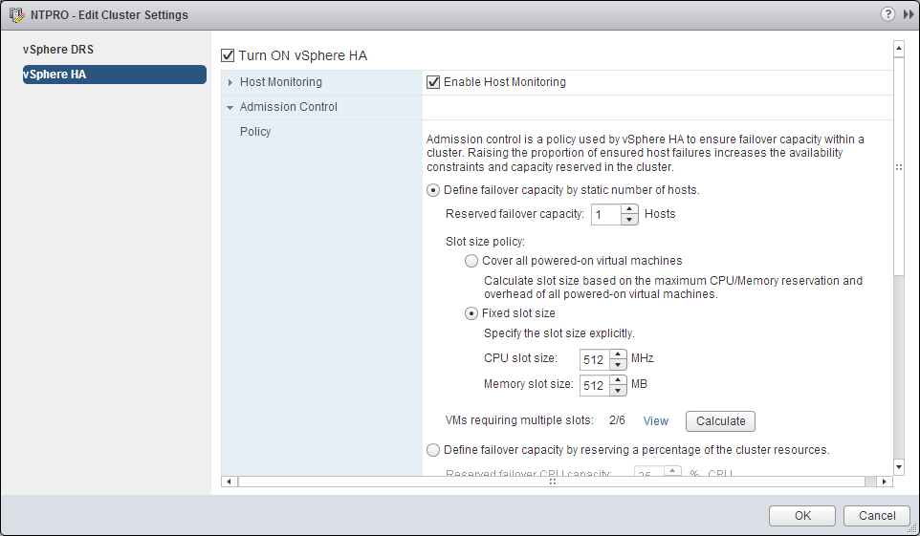
Specify a fixed slot size explicitly

Slide 10
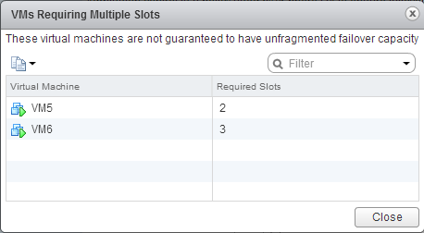
VMs requiring multiple slots
VM1
VM2
VM3
VM4
VM5
VM6
Slot size
512 MHz
512 MB
Reservation
You can also determine the risk of resource fragmentation in your cluster by viewing the number of virtual machines that require multiple slots.
VMs might require multiple slots if you have specified a fixed slot size or a maximum slot size using advanced options.

Slide 11
Fragmented failover capacity
ESX1
ESX2
ESX3
Shared storage – vm.vmdk

Slide 12
Worst case scenario
ESX01 3.6 GHz 16 GB
ESX02 3.6 GHz 16 GB
ESX03 3.6 GHz 32 GB
Shared storage – vm.vmdk

Slide 13
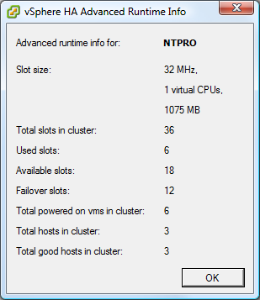
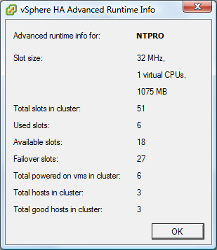
Keep hosts the same size
Host memory: 3 * 16 GB
Host memory: 2 * 16 GB
1 * 32 GB

Slide 14
Percentage of Cluster Resources Reserved
ESX01
ESX02
ESX03
Shared storage – vm.vmdk

Slide 15
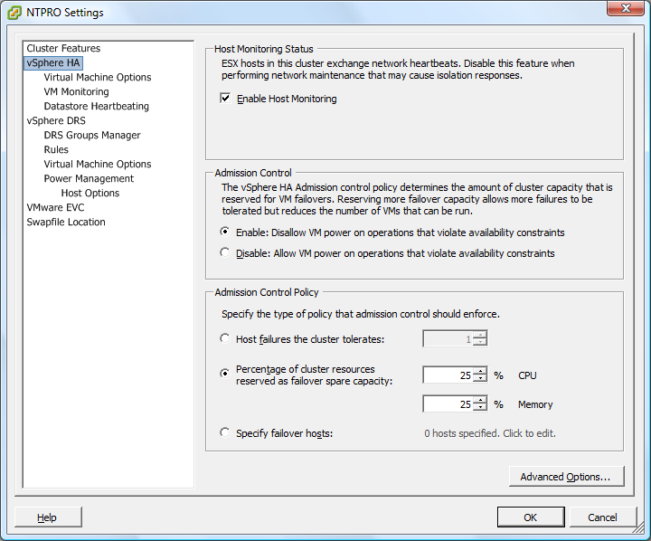
Percentage reserved as failover capacity

Slide 16
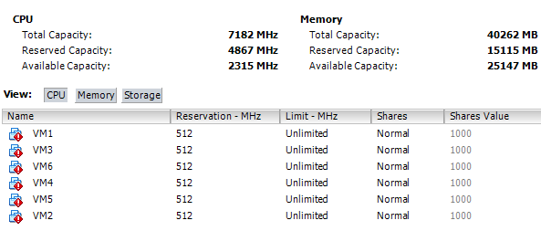
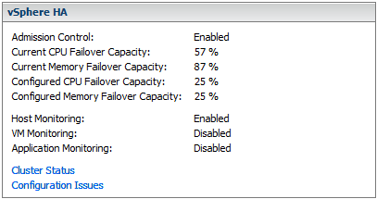
Admission control based on reservations
vSphere HA uses the actual individual reservations of the virtual machines.
The CPU component by summing the CPU reservations of the powered-on VMs.

Slide 17
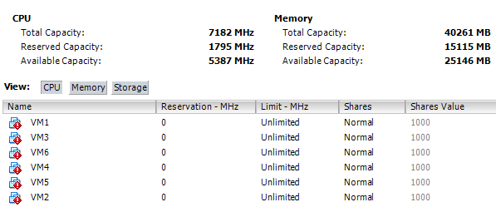
Computing the Current Failover Capacity
If you have not specified a CPU reservation for a VM, it is assigned a default value of 32MHz

Slide 18
Resources Reserved is not Utilization
The Current CPU Failover Capacity is computed by subtracting the total CPU resource requirements from the total host CPU resources and dividing the result by the total host CPU resources.

Slide 19
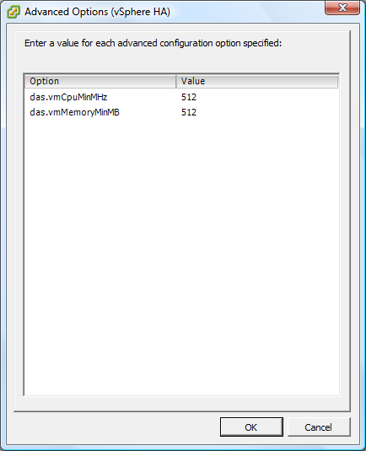
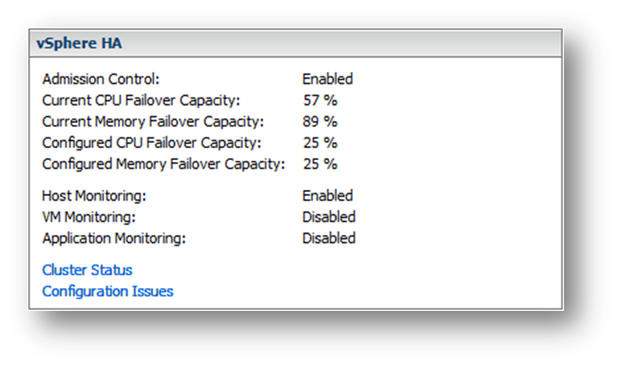
Percentage reserved advanced setting
The default CPU reservation for a VM can be changed using the das.vmcpuminmhz advanced attribute
das.vmmemoryminmb defines the default memory resource value assigned to a VM

Slide 20
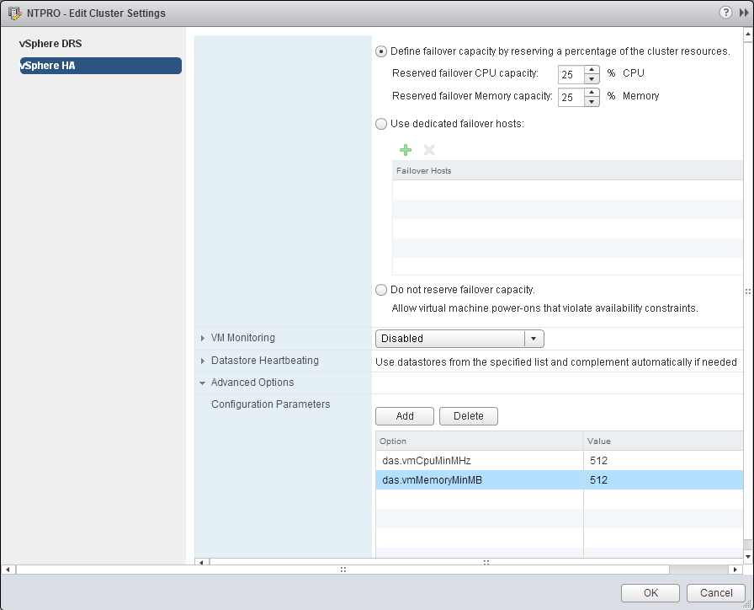
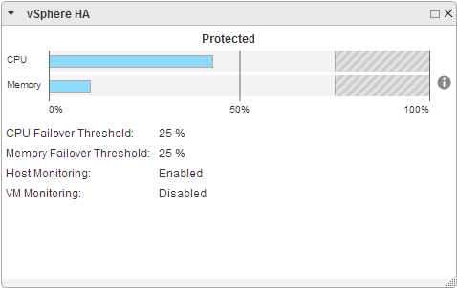
What about the web client

Slide 21
Specify Failover Hosts Admission Control Policy
ESX01
ESX02
ESX03
Shared storage – vm.vmdk

Slide 22
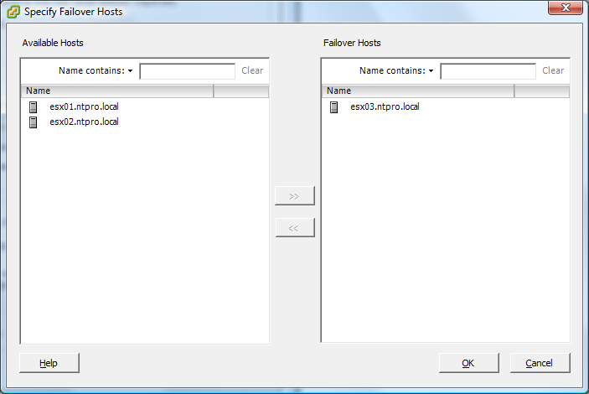
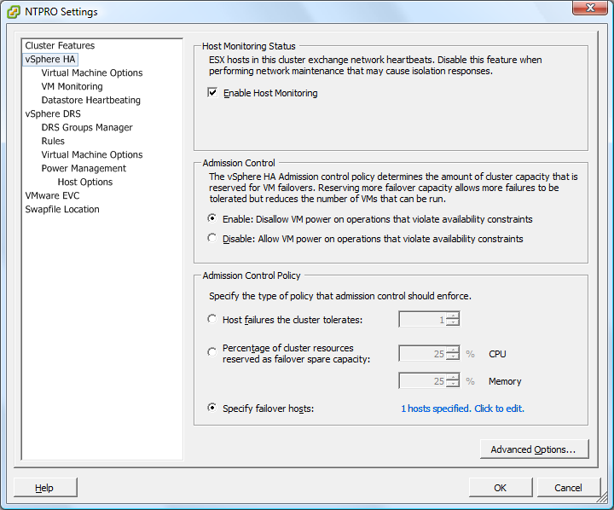
Specify Failover Hosts Admission Control Policy
Configure vSphere HA to designate specific hosts as the failover hosts

Slide 23
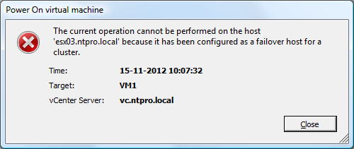
The failover host
To ensure that spare capacity is available on a failover host, you are prevented from powering on virtual machines or using vMotion to migrate VMs to a failover host. Also, DRS does not use a failover host for load balancing If you use the Specify Failover Hosts admission control policy and designate multiple failover hosts, DRS does not attempt to enforce VM-VM affinity rules for virtual machines that are running on failover hosts.

Slide 24
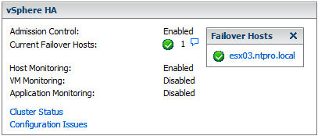
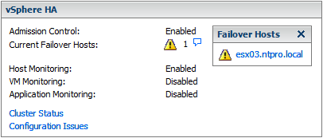
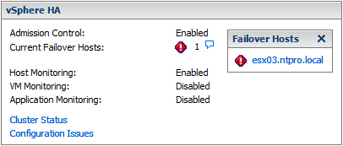
Status of the Current Failover Hosts
Green - The host is connected, not in maintenance mode, and has no vSphere HA errors. No powered-on VMs reside on the host.
Yellow - The host is connected, not in maintenance mode, and has no vSphere HA errors. However, powered-on VMs reside on the host.
Red - The host is disconnected, in maintenance mode, or has vSphere HA errors.

Slide 25
Conclusions
VMware High Availability needs to be configured
Be careful with reservations
Always check run-time information

Slide 26
Module 2
HA datastore heartbeats and host isolation

Slide 27
Datastore heartbeats host-X-hb
host-X-hb (where X is the host’s MOID) – Located on each heartbeat datastore, this file is used to check for slave liveness through the heartbeat datastore.
This file is checked by the master host if the master loses network heartbeats from the slave.
For VMFS datastores, the vSphere HA agent locks this file with an exclusive lock and relies on the VMkernel heartbeat to indicate liveness.
For NFS datastores, vSphere HA periodically updates the time stamp to this file to indicate liveness.

Slide 28
Datastore heartbeats host-X-poweron
host-X-poweron (where X is the host’s MOID) – A per-host file that contains the list of all virtual machines that are powered on.
This file is used as a communication channel if a management network outage occurs.
Isolated slaves use this file to tell the master that it is isolated as well as to tell the master which virtual machines it has powered off.

Slide 29
The slave does not respond
The master host must determine whether the slave host:
Actually crashed
Is not responding because of a network failure
The HA agent is in an unreachable state
The absence of both a network and datastore heartbeat indicates full host failure.

Slide 30
The Laboratory
Gateway
Slave
Master
Master
ESX1-15Ghz-15GB
ESX3-15Ghz-15GB
host-X-hb
host-X-poweron

Slide 31
Conclusions
Datastores are used as a backup communication channel to detect virtual machine and host heartbeats.
Datastore heartbeats are used to make the distinction between a failed, an isolated or a partitioned host.

Slide 32
VMworldTV
http://www.youtube.com/VMworldTV

